Slide 1


CAR SALES – Data Analysis
by Madhusudanan Subbarao

Slide 2
Introduction – Car Sales Dataset
This is the Car sales data set which include information about different cars . This data set is being taken from the Github. It covers over 9500 car sales data including various type of models, engine type, volume manufactured by various global automobile organization since 1950’s to 2016. Also It contains details with mileage and pricing along with registration year to get to know the trend of cars preferred by consumers in relation to the old models to latest models.

Slide 3
Car Sales - Analysis
Dataset contains information on the different types of cars sold. It comprises of 9576 rows which is the count of cars sold and 10 columns like car manufacturer, engine volume, body , engine type, price, mileage, registration, year, model and drive. Few columns has been duplicated and does contain incorrect values and also missing values. Data contains car details of different manufactures who has stopped manufacturing and also who has merged or acquired by others. We considered entire dataset after cleaning the dataset based on appropriate process. we have to analyze which feature has more impact on car sales and carry out result of this.
Source file link -
https://raw.githubusercontent.com/insaid2018/Term-1/master/Data/Projects/car_sales.csv

Slide 4
Problem statement
How the price is determined and how it impacted the sales of the car.
Which registered year cars sold maximum
Impact of features in the sales
We can see in the dataset, sales of very old models too. Need to analyze whether it is worth to invest in stocking those cars.
Is it financially beneficial - the vintage or latest cars.

Slide 5
EDA
EDA is to analyze the dataset with basic use of pandas and drawing conclusion from the data through different graphical analysis of the dataset. We tried to explore the dataset through different questions and also answered. Cleaned up dataset was used for analysis purpose.
Preprocessing observations:
Total Number of Variables = 10 (Numeric 4, Categorical =6) Number of Observations = 9576
Car and Model has a high cardinality = 87 and 888 distinct values respectively. Drive & engV has 5.3% & 4.5% of missing values. Mileage & Price has 3.6% & 2.8% of Zeros. Dataset has 113 duplicate rows.
Actions taken to clean up the data:
Dropping all the duplicates and price with zeros. Dropping engV which is more than 8 which is incorrect as it contains only 62 counts.
Replaced all Zeros in mileage column with mean value. Replaced all missing values of engV with mean values. Replaced all missing values of Drive with mode value.
Cleaned data file -
Final Dataset considered for Analysis:
As Count of sold cars belongs to registered year beyond 2000 is more, for further analysis we considered data beyond Year 2000 for analysis.
EDA file

Slide 6
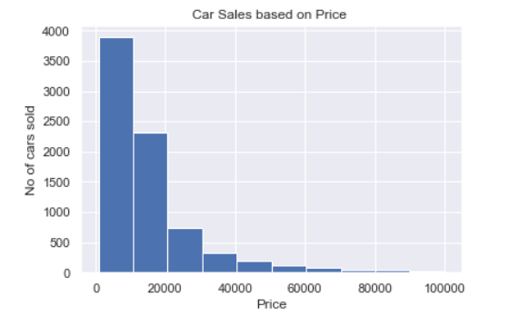
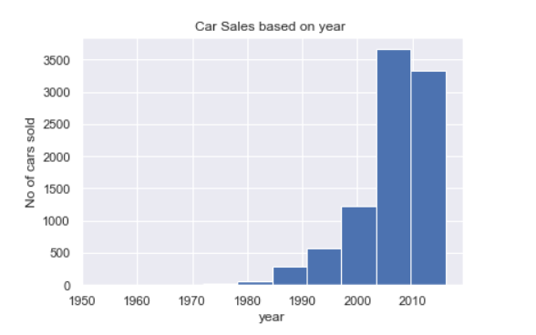
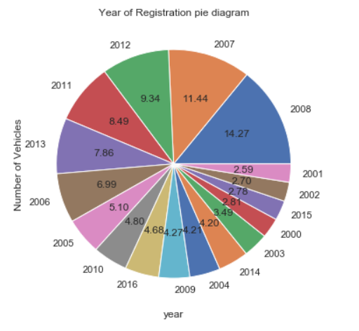
Cars sold based on Price/ Year
Notes:
Above count chart provide details of no of car sold based on car price and year of registration.

Slide 7
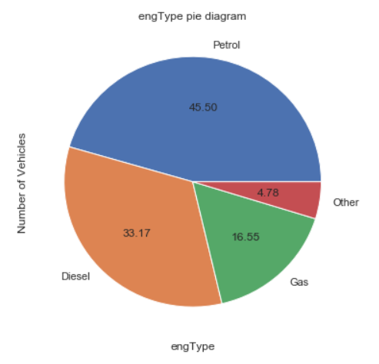
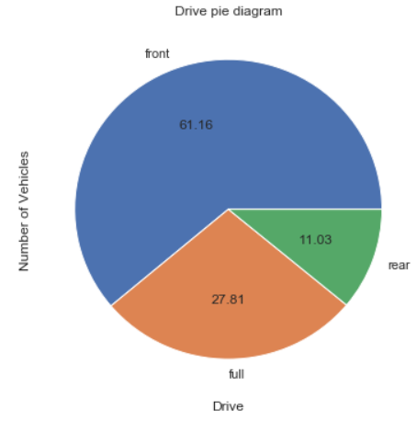
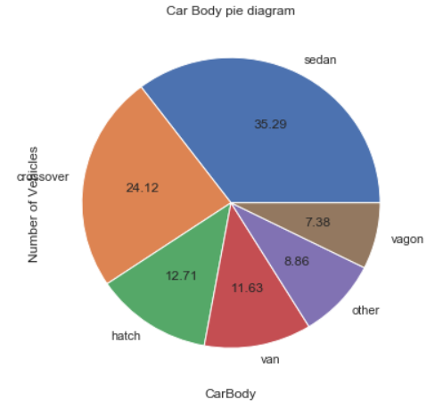
Univariate analysis of variables - Engine Type, Body and Drive Pie Graph
Notes:
As the year of registration of the cars sold is maximum since 2000. We will consider further analysis from the year 2000.
Above chart represents engType /body/drive of the car sold maximum.

Slide 8
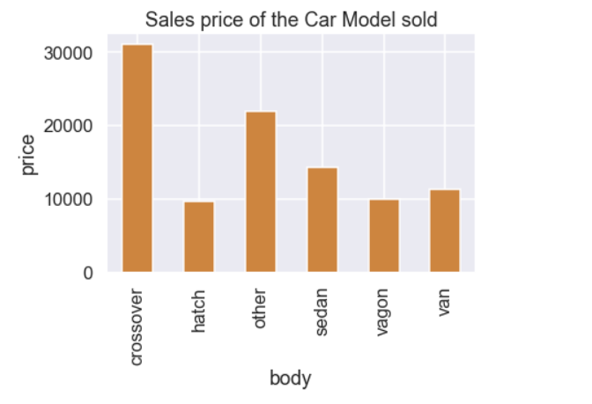
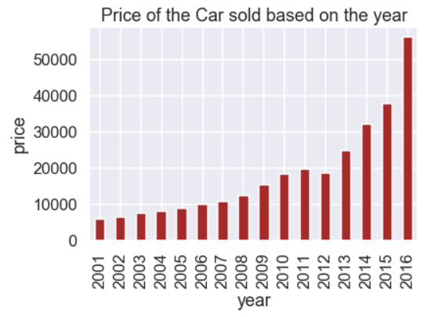
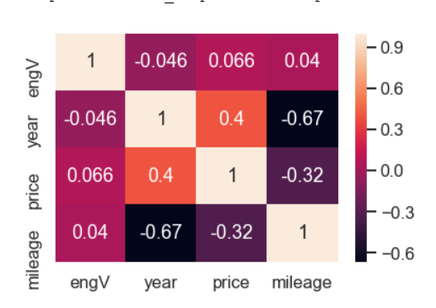
Price determination factor
Estabalishing Correlation using Heat Map
Notes:
On the basis of the above chart, prices are determined based on the year of registration. Year is closely correlated with price but surprising mileage is negatively correlated with both year and price.

Slide 9
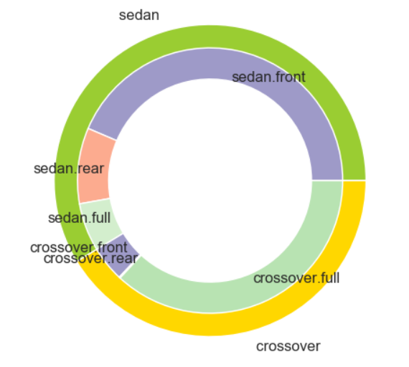
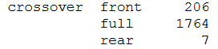
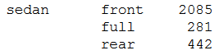
Bivariate Analysis - Body type with Drive - Donut Chart
Outer Pie [body] - Sedan , Crossover
Inner Pie[drive] - sedan.front, sedan.rear ,sedan.full ,crossover.front,crossover.rear,crossover.full,
Notes:
As sedan & Crossover forms more than 50% of total sales, further analyse based on those two. Most of the front drive vehicles sold are of sedan and most of the full drive vehicles of are of crossover.

Slide 10
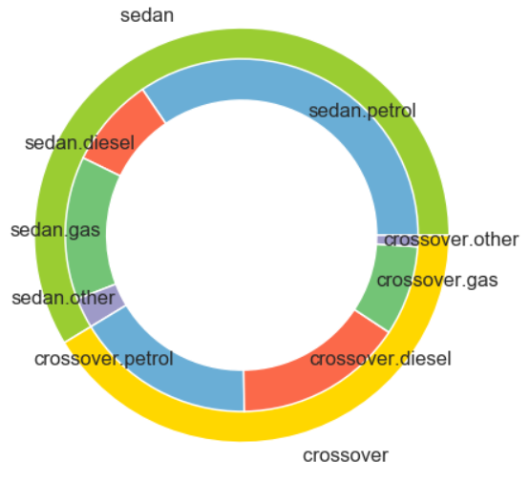
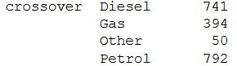
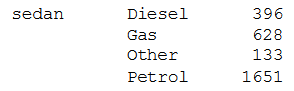
Bivariate Analysis - Body type with EngType - Donut Chart
Outer Pie [body] - Sedan , Crossover
Inner Pie[drive] - sedan.petrol,sedan.diesel,sedan.gas,sedan.other,crossover.petrol,crossover.diesel,crossover.gas,crossover.other
Notes:
Most of the sold sedans are petrol engines and in case of crossover both diesel and petrol are evenly sold.

Slide 11
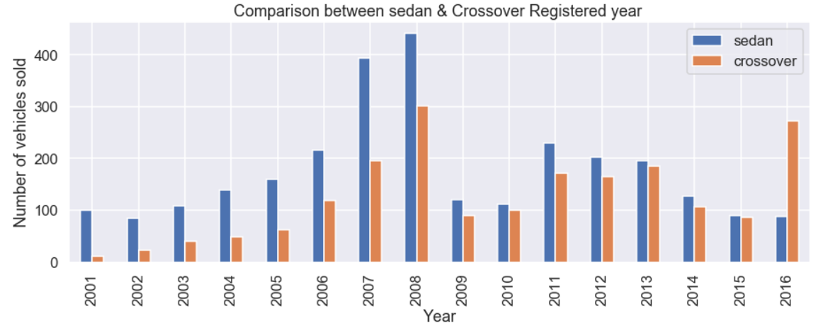
Bivariate Analysis - Registration Year of Sedan & Crossover Sold
Above chart indicates the cars registered during 2007 and 2008 sold much In both the cases.
Notes:
Above chart provides an interesting trend of the vehicles sold. Those registered on 2007 & 2008 had sold maximum in comparison to the other years in both the cases. But at the same time crossover’s latest registered cars has sold much in comparison to sedan.

Slide 12
Conclusion
Cars sales dataset contains data of cars registered since 1950's but when we counted the sales of car based on registered year, the count was more relevant from 2000 only. So it clearly indicates people are not favorable with the old cars.(Slide-6)
To establish correlation of variables impacting the price we used heat map. Surprisingly not mileage or engineVolume but year of registration is closely correlated.(Slide-8)
As per the analysis, price of the car has been defined based on the year of registration. More costlier if the car is latest. .(Slide-8)
We have seen the impact of columns like body, price, year and engType on the sales of the car.(Slide-7)
Based on the body - sedan and Crossover has contributed to more than 50% of the sales.- (ref : Pie- Graph)-(Slide-7)
Cars 5 to 10 years old are preferred by the customers if the body and price is satisfied.
Customer gives preference to petrol or diesel cars and Crossover with Full drive and Sedan with Front drive is preferred. Ref- Donut Chart(Slide-9,10)
Crossover with both petrol or diesel is preferred but in case of sedan it is petrol.
As a conclusion, cars with specification like - comfort to a family( midsize SUV ), standard engine volume, either petrol or diesel eng type and with full or front drive even though it is 5 to 10 years, old has been preferred much. It is suggestable to stock the cars which are of smallsize or midsize SUV's as those are most preferred.

